Slide 1



Ensemble Earthquake Early Warning System (E3WS) Performance Testing by PNSN-Curated Data
Nate Stevens, Benz Poobua, Jake Ward
University of Washington, PNSN
Notes:
https://around.uoregon.edu/content/earthquake-early-warning-now-available-oregon-public

Slide 2
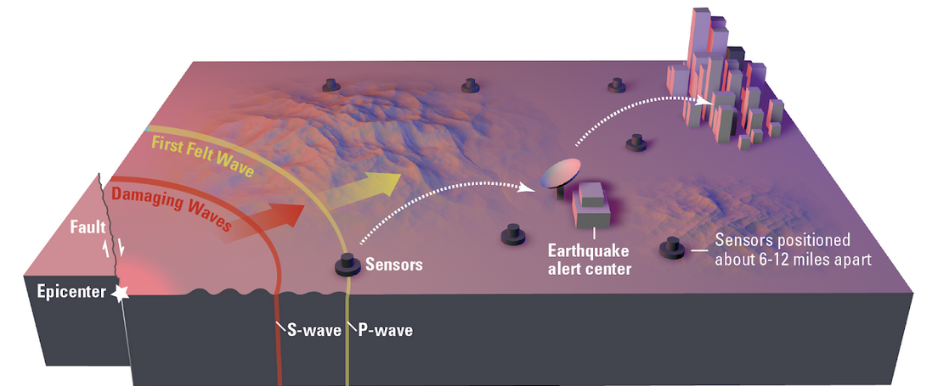
Introduction
Motivation
Limitations
Nearly 1 million deaths due to earthquakes since 1990 (Pal et al., 2023)
Earthquake Early Warning System used to mitigate human losses
Most EEWS are based on multi-station data (more information and trade-off delays)
Most single-sensor-based algorithms only contain some components of an EEWS (detection, picking, magnitude, or location)
(citation)
1
Notes:
https://earthquake.ca.gov/how-it-works/
In an earthquake, a rupturing fault sends out two different types of waves. The fast-moving P-wave is first to arrive, but the damage is caused by the slower S-waves and surface waves.
Sensors detect the P-wave and immediately transmit data to an earthquake alert center where the location and size of the quake are determined and updated as more data becomes available.
A message from the alert center is immediately transmitted to users.
- The single-station based EEWS: faster approach
- Trade-off between the earliest alert time and the accuracy of the estimates (Meier, 2017)

Slide 3
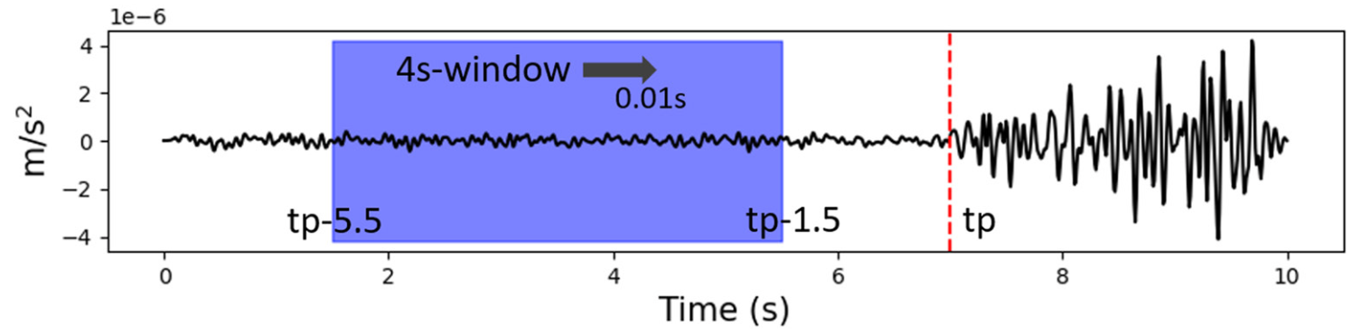
Introduction
Inspiring Literatures
Lara et al. (2023)
E3WS: the first EEWS in which all components (detection, picking, and source parameters) are based on AI
3 seconds of recorded by a single 3-component instrument
For near seismic sources (less than 200 km)
Detector, P-phase picker,
Source Characterization (regression models): magnitude, epicentral distance, back azimuth, and depth of the source
2
Notes:
Lara, Pablo, Quentin Bletery, Jean‐paul Ampuero, Adolfo Inza, and Hernando Tavera. "Earthquake Early Warning starting from 3 s of records on a single station with machine learning." Journal of Geophysical Research: Solid Earth 128, no. 11 (2023): e2023JB026575.
- Look at page 3; last3 lines describing a feature vector

Slide 4
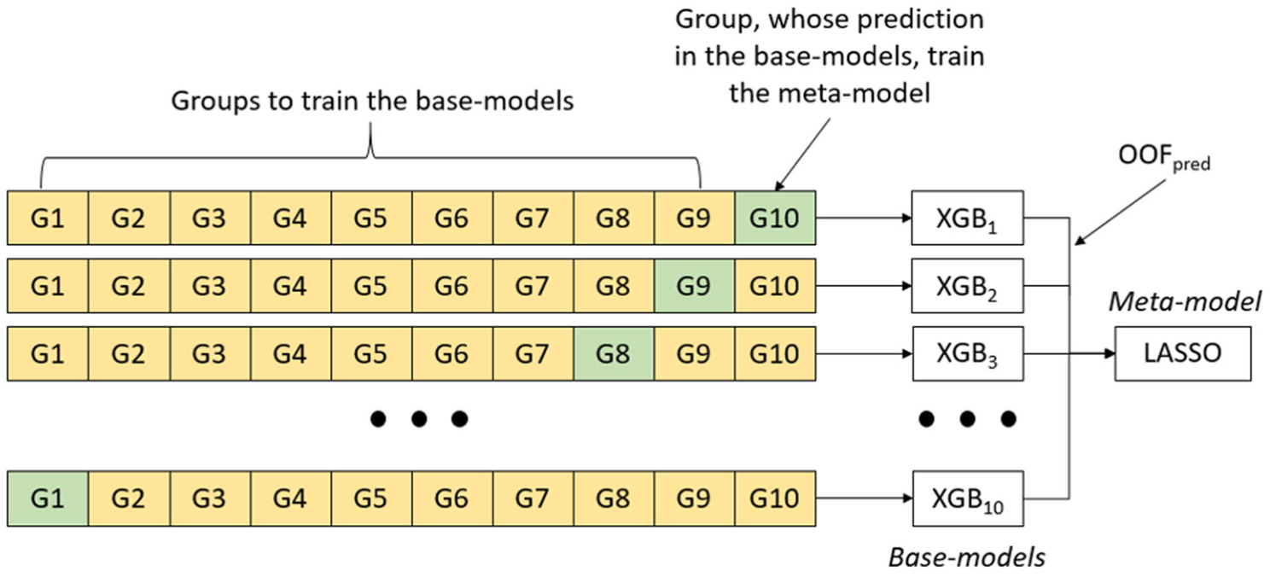
Introduction
Project Question
Is the performance of our model using PNSN-curated data better or worse, relative to the work of Lara et al. (2023)?
How can we improve the model’s performance?
what are the contributing factors causing the model uncertainty?
ML Approaches
Stacking algorithm
K-fold validation (K = 10)
XGBoost
LASSO
(Lara et al., 2023)
3

Slide 5
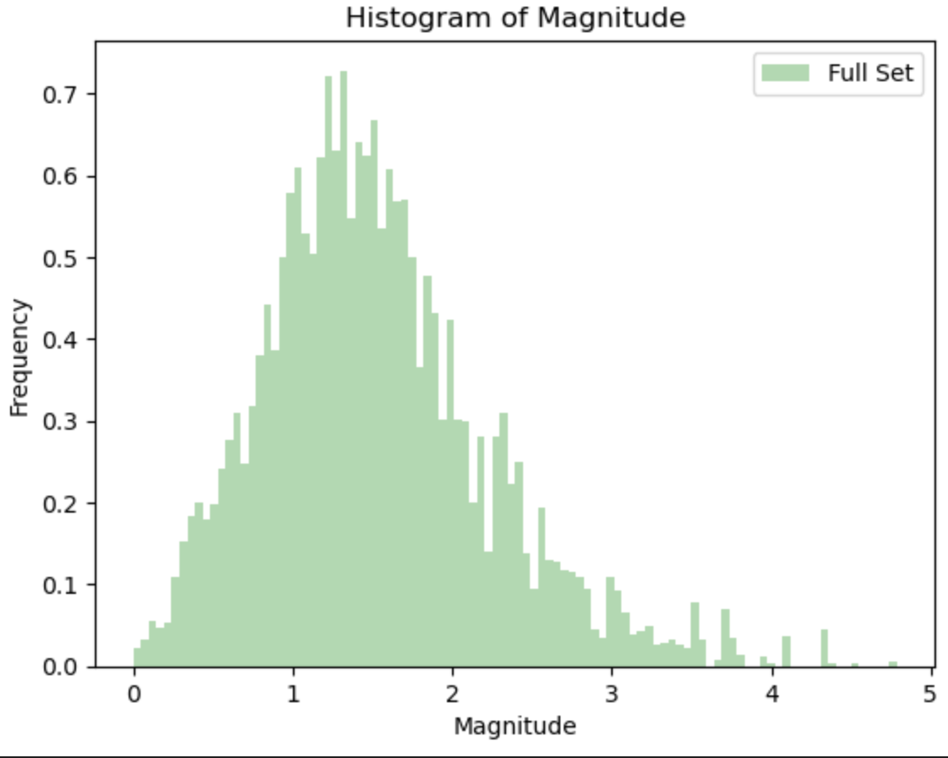
Methodology
Part 1: Data Processing (Data Characterizing/Curating)
From https://pnsn.org
latitude range: 42 - 49 °N
longitude range 122 - 125.5 °W
magnitude range: 0 - 8
Exclude Mount St. Helens events: True
Date Range: 2015-01-01 to 2023-11-17
X = feature vectors numpy array (65821,140)
Dimensionality Reduction
y = magnitude numpy array (65821,1)
Note We focus on magnitude for this project
4

Slide 6
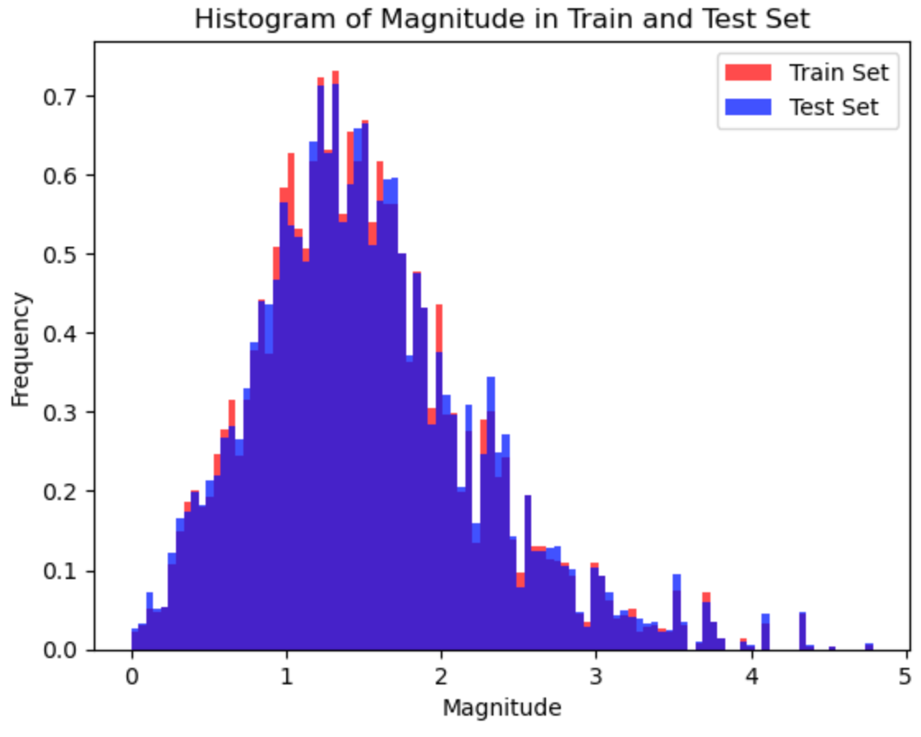
Methodology
Part 1: Data Processing (Data Splitting)
80% train + 20% test
X_train.shape = (52656, 140)
X_test.shape = (13165, 140)
y_train.shape = (52656, 1)
y_test.shape = (13165, 1)
5

Slide 7
Methodology
Part 2: ML Approach Workflow (not finished)
Type of data
Feature vectors (f000 - f139) as input to XGBoost
Numpy array (1,140)
2. K-Fold Cross Validation
ss
3. XGBoost
ss
6
Notes:
- Feature vectors discussion here (as input fed to XGBoost)

Slide 8
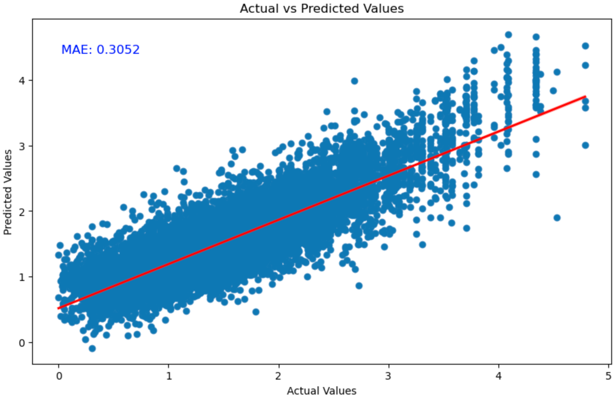
Model Results
MAE for train set = 0.28282909989356997
MAE for test set = 0.3052198588848114
7

Slide 9
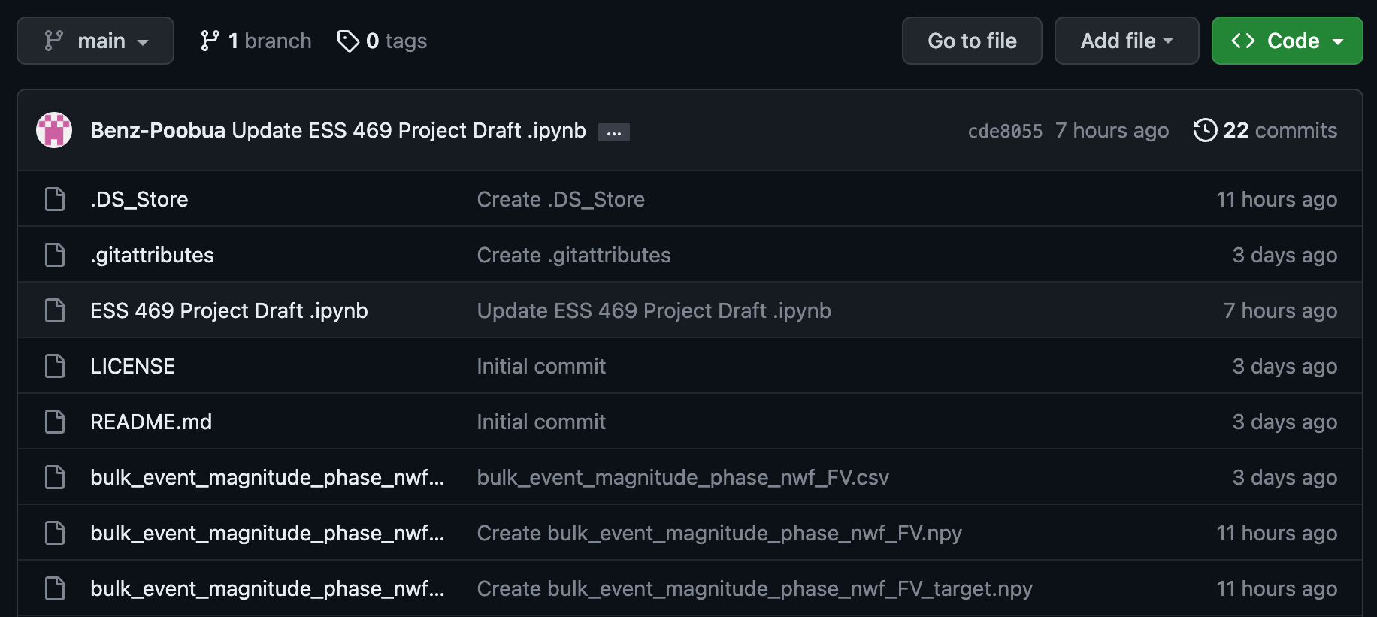
Reproducibility
Script and Datasest provided in Github
https://github.com/UW-ESS-DS/mlgeo-2023-PNSN-E3WS/tree/feature-stevens-examples
https://github.com/Benz-Poobua/ESS-469-Project
script
datasets
8

Slide 10
References
Lara, Pablo, Quentin Bletery, Jean‐paul Ampuero, Adolfo Inza, and Hernando Tavera. "Earthquake Early Warning starting from 3 s of records on a single station with machine learning." Journal of Geophysical Research: Solid Earth 128, no. 11 (2023): e2023JB026575.
9

